Slide 1
Control Structures

Slide 2
Objectives
At the end of the lesson, the student should be able to:
Use decision control structures (if, else, switch) which allows selection of specific sections of code to be executed.
Use repetition control structures (while, do-while, for) which allow executing specific sections of code a number of times.
Use branching statements (break, continue) which allows redirection of program flow.

Slide 3
Control Structures
Control structures
- allows us to change the ordering of how the statements in our programs are executed
● Two types of Control Structures
- decision control structures
● allows us to select specific sections of code to be executed
- repetition control structures
● allows us to execute specific sections of the code a number of times

Slide 4
Decision Control Structures
● Decision control structures
- Java statements that allows us to select and execute specific blocks of code while skipping other sections
● Types:
- if-statement
- if-else-statement
- If-else if-statement

Slide 5
if-statement
● if-statement
- specifies that a statement (or block of code) will be executed if and only if a certain boolean statement is true.
● if-statement has the form:
if( boolean_expression ) statement;
or
if( boolean_expression ){ statement1;
statement2;
}
- where,
● boolean_expression is either a boolean expression or boolean variable.

Slide 6
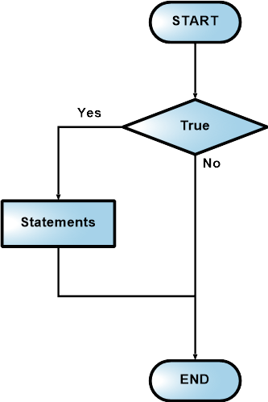
if-statement Flowchart

Slide 7
Example 1
int grade = 68; if( grade > 60 )
System.out.println("Congratulations!");

Slide 8
Example 2
int grade = 68;
if( grade > 60 ){
System.out.println("Congratulations!"); System.out.println("You passed!");
}

Slide 9
Coding Guidelines
1. The boolean_expression part of a statement should
evaluate to a boolean value. That means that the execution of the condition should either result to a value of true or a false.
2. Indent the statements inside the if-block. For example,
if( boolean_expression ){ //statement1;
//statement2;
}

Slide 10
if-else statement
● if-else statement
- used when we want to execute a certain statement if a condition is true, and a different statement if the condition is false.
● if-else statement has the form:
if( boolean_expression ){ statement1;
statement2;
}
else{
statement3; statement4;
}

Slide 11
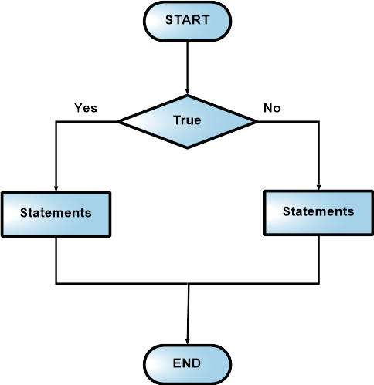
Flowchart

Slide 12
Example 1
int grade = 68;
if( grade > 60 )
System.out.println("Congratulations!");
else
System.out.println("Sorry you failed");

Slide 13
Example 2
int grade = 68;
if( grade > 60 ){
System.out.println("Congratulations!"); System.out.println("You passed!");
}
else{
System.out.println("Sorry you failed");
}

Slide 14
Coding Guidelines
1. To avoid confusion, always place the statement or statements of an if or if-else block inside brackets {}.
2. You can have nested if-else blocks. This means that you can have other if-else blocks inside another if-else block.
For example,
if( boolean_expression ){
if( boolean_expression ){ //some statements here }
}
else{
//some statements here
}

Slide 15
if-else-if statement
● The statement in the else-clause of an if-else block can be another if-else structures.
● This cascading of structures allows us to make more complex selections.
● The statement has the form:
if( boolean_expression1 ) statement1;
else if( boolean_expression2 ) statement2;
else
statement3;

Slide 16
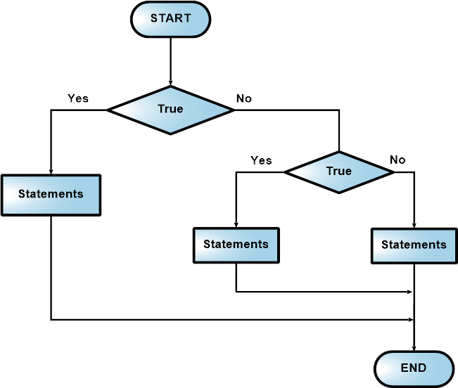
Flowchart

Slide 17
Example
int grade = 68;
if( grade > 90 ){
System.out.println("Very good!");
}
else if( grade > 60 ){
System.out.println("Very good!");
}
else{
System.out.println("Sorry you failed");
}

Slide 18
Common Errors
1. The condition inside the if-statement does not evaluate to a boolean value. For example,
//WRONG
int number = 0; if( number ){
//some statements here
}
The variable number does not hold a boolean value.
2. Writing elseif instead of else if.

Slide 19
Common Errors
3. Using = instead of == for comparison. For example,
//WRONG
int number = 0;
if( number = 0 ){
//some statements here }
This should be written as,
//CORRECT
int number = 0;
if( number == 0 ){
//some statements here }

Slide 20
Sample Program
public class Grade {
public static void main( String[] args ) {
double grade = 92.0; if( grade >= 90 ){
System.out.println( "Excellent!" ); }
else if( (grade < 90) && (grade >= 80)){ System.out.println("Good job!" ); }
else if( (grade < 80) && (grade >= 60)){ System.out.println("Study harder!" ); }
else{
System.out.println("Sorry, you failed.");
}
}
}

Slide 21
switch-statement
● switch
- allows branching on multiple outcomes. ● switch statement has the form:
switch( switch_expression ){ case case_selector1:
statement1;//
statement2;//block 1 break;
case case_selector2: statement1;//
statement2;//block 2 break;
:
default:
statement1;//
statement2;//block n
}

Slide 22
switch-statement
● where,
- switch_expression
● is an integer or character expression
- case_selector1, case_selector2 and so on,
● are unique integer or character constants.

Slide 23
switch-statement
● When a switch is encountered,
- Java first evaluates the switch_expression, and jumps to the case whose selector matches the value of the expression.
- The program executes the statements in order from that point on until a break statement is encountered, skipping then to the first statement after the end of the switch structure.
- If none of the cases are satisfied, the default block is executed. Take note however, that the default part is optional.

Slide 24
switch-statement
● NOTE:
- Unlike with the if statement, the multiple statements are executed in the switch statement without needing the curly braces.
- When a case in a switch statement has been matched, all the
statements associated with that case are executed. Not only that, the statements associated with the succeeding cases are also executed.
- To prevent the program from executing statements in the
subsequent cases, we use a break statement as our last statement.

Slide 25
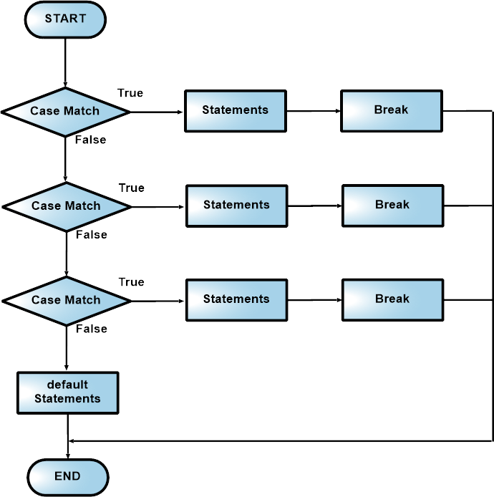
Flowchart

Slide 26
Example
public class Grade
{
public static void main( String[] args )
{
int grade = 92;
switch(grade){
case 100:
System.out.println( "Excellent!" );
break;
case 90:
System.out.println("Good job!" );
break;
case 80:
System.out.println("Study harder!" );
break;
default:
System.out.println("Sorry, you failed.");
}
}
}

Slide 27
Coding Guidelines
1. Deciding whether to use an if statement or a switch
statement is a judgment call. You can decide which to use, based on readability and other factors.
2. An if statement can be used to make decisions based on
ranges of values or conditions, whereas a switch statement can make decisions based only on a single integer or character value. Also, the value provided to each case statement must be unique.

Slide 28
Repetition Control Structures
● Repetition control structures
- are Java statements that allows us to execute specific blocks of code a number of times.
● Types:
- while-loop
- do-while loop
- for-loop

Slide 29
while-loop
● while loop
- is a statement or block of statements that is repeated as long as some condition is satisfied.
● while loop has the form:
while( boolean_expression ){ statement1;
statement2;
}
- The statements inside the while loop are executed as long as the boolean_expression evaluates to true.

Slide 30
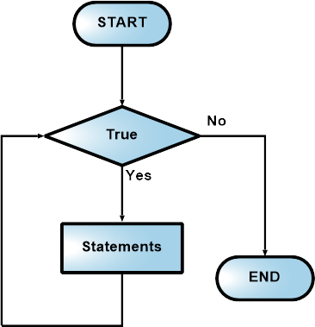
Flowchart

Slide 31
Example 1
int x = 0;
while (x<10)
{
System.out.println(x);
x++;
}

Slide 32
Example 2
//infinite loop while(true)
System.out.println(“hello”);

Slide 33
Example 3
//no loops
// statement is not even executed while (false)
System.out.println(“hello”);

Slide 34
do-while-loop
● do-while loop
- is similar to the while-loop
- statements inside a do-while loop are executed several times as long as the condition is satisfied
- The main difference between a while and do-while loop:
● the statements inside a do-while loop are executed at least once.
● do-while loop has the form:
do{
statement1; statement2;
}while( boolean_expression );

Slide 35
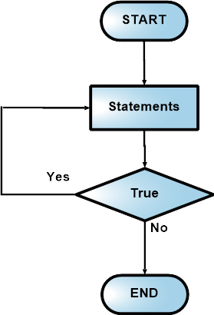
Flowchart

Slide 36
Example 1
int x = 0;
do
{
System.out.println(x);
x++;
}while (x<10);

Slide 37
Example 2
//infinite loop do{
System.out.println(“hello”); } while (true);

Slide 38
Example 3
//one loop
// statement is executed once do
System.out.println(“hello”); while (false);

Slide 39
Coding Guidelines
1. Common programming mistakes when using the do-while loop is forgetting to write the semi-colon after the while expression.
do{
}while(boolean_expression)//WRONG->forgot semicolon;
2. Just like in while loops, make sure that your do-while loops will terminate at some point

Slide 40
for-loop
● for loop
- allows execution of the same code a number of times.
● for loop has the form:
for(InitializationExpression;LoopCondition;StepExpression) {
statement1; statement2;
}
- where,
● InitializationExpression -initializes the loop variable.
● LoopCondition - compares the loop variable to some limit value. ● StepExpression - updates the loop variable.

Slide 41
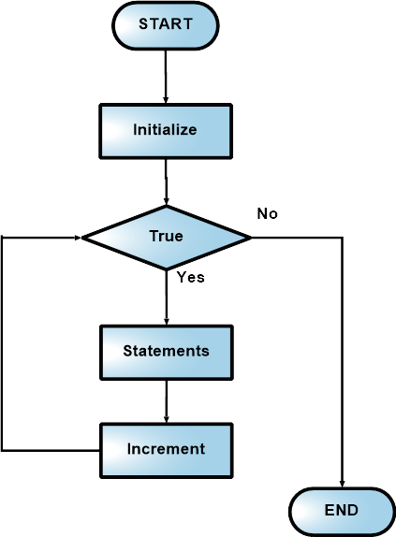
Flowchart

Slide 42
Example
int i;
for( i = 0; i < 10; i++ ){ System.out.println(i); }
● The code shown above is equivalent to the following while loop.
int i = 0;
while( i < 10 ){
System.out.print(i); i++;
}

Slide 43
Branching Statements
● Branching statements allows us to redirect the flow of program execution.
● Java offers branching statements:
- break
- continue

Slide 44
Break statement
- terminates the enclosing switch statement, and flow of control transfers to the statement immediately following the switch.
- This can also be used to terminate a for, while, or do-while loop

Slide 45
Example
public class Test{
public static void main(String args[]){
for(int i=0; i<10; i++){
System.out.println(i);
if(i == 5) break;
}
}
}

Slide 46
Continue statement
- skips to the end of the innermost loop's body and evaluates the boolean expression that controls the loop, basically skipping the remainder of this iteration of the loop.

Slide 47
Example
public class Test{
public static void main(String args[]){
for(int i=0; i<10; i++){
if(i == 5) continue;
System.out.println(i);
}
}
}

Slide 48
Summary
● Decision Control Structures
- if
- if-else
- if - else if
- switch
● Repetition Control Structures
- while
- do-while
- for
● Branching Statements
- break
- continue

